Slide 1
Feasibility Analysis & Report

Slide 2
Overview
What is a feasibility study
Identify four type of feasibility
List relevant questions for each type of feasibility
Identify features relating to cost benefit analysis
Describe the components of a feasibility Study

Slide 3
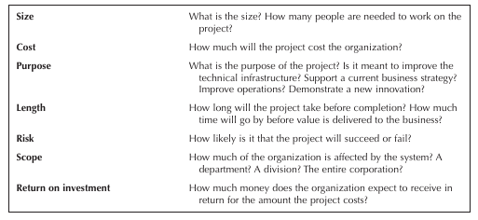
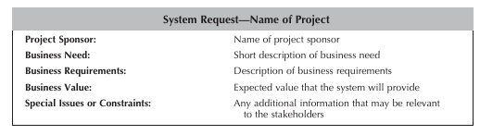
Project Identity + Selection = Feasibility Study
Project Identification
Business need
Project Sponsor
Business value - tangible and or intangible
System Request
Project Selection

Slide 4
Feasibility Study
What is a feasibility study?
What to study and conclude?
Types of feasibility
Technical
Economic
Schedule
Operational
Quantifying benefits and costs
Payback analysis
Net Present Value Analysis
Return on Investment Analysis
Comparing alternatives

Slide 5
Why a feasibility study?
Objectives:
  To find out if a system development project can be done:
    ...is it possible?
    ...is it justified?
  To suggest possible alternative solutions.
  To provide management with enough information to know:
    Whether the project can be done
    Whether the final product will benefit its intended users
    What the alternatives are (so that a selection can be made in subsequent phases)
    Whether there is a preferred alternative
A management-oriented activity:
  After a feasibility study, management makes a “go/no-go” decision.
  Need to examine the problem in the context of broader business strategy

Slide 6
Content of a feasibility study
Things to be studied in the feasibility study:
The present organizational system
Stakeholders, users, policies, functions, objectives,...
Problems with the present system
inconsistencies, inadequacies in functionality, performance,…
Goals and other requirements for the new system
Which problem(s) need to be solved?
What would the stakeholders like to achieve?
Constraints
including nonfunctional requirements on the system (preliminary pass)
Possible alternatives
“Sticking with the current system” is always an alternative
Different business processes for solving the problems
Different levels/types of computerization for the solutions
Advantages and disadvantages of the alternatives
Things to conclude:
Feasibility of the project
The preferred alternative.

Slide 7
Exploring Feasibility
The “PIECES” framework
  Useful for identifying operational problems to be solved, and their urgency
  Performance
    Is current throughput and response time adequate?
  Information
    Do end users and managers get timely, pertinent, accurate and usefully formatted information?
  Economy
    Are services provided by the current system cost-effective?
    Could there be a reduction in costs and/or an increase in benefits?
  Control
    Are there effective controls to protect against fraud and to guarantee information accuracy and security?
  Efficiency
    Does current system make good use of resources: people, time, flow of forms,…?
  Services
    Are current services reliable? Are they flexible and expandable?
See the course website for a more specific list of PIECES questions

Slide 8
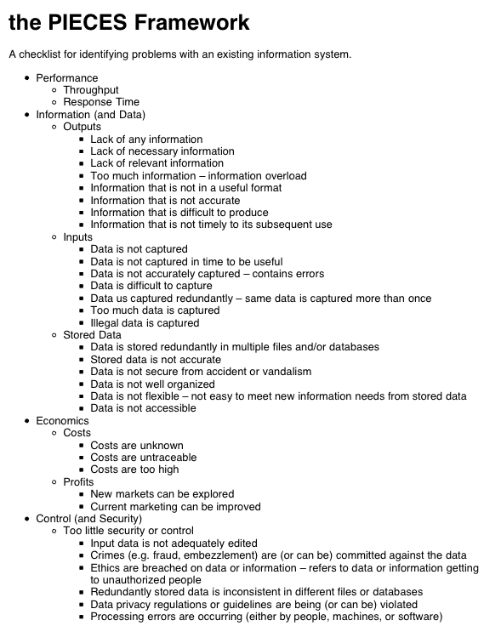
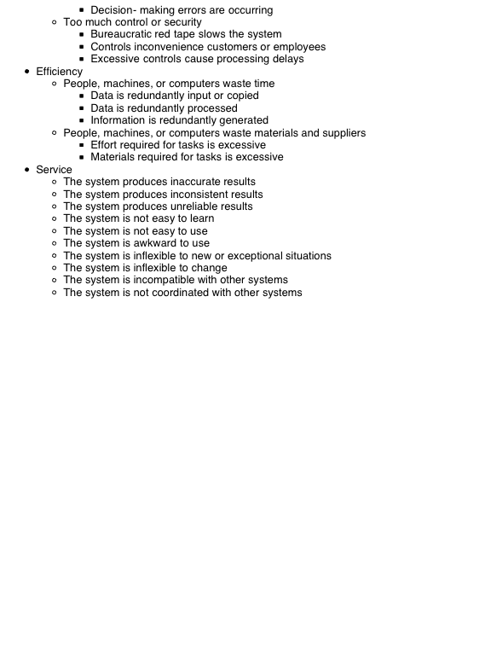

Slide 9
Feasibility
Four Types of Feasibility:
  Technical
  Economic
  Operational
  Schedule

Slide 10
Technical Feasibility
Can we build it?
Familiar with Functional area, less familiarity generates more risks
Familiar with Technology
Project size – larger projects have more risks
Compatibility – harder it is to integrate the system with the company’s existing system increases risks

Slide 11
Technical Feasibility Questions
Is the project possible with current technology?
What technical risk is there?
Availability of technology:
  Is it available locally?
  Where can it be obtained?
  Will it be compatible with other systems?

Slide 12
Economic Feasibility
Should we Build it?
Development costs
Annual operating costs
Annual benefits (cost savings and revenues)
Intangible costs and benefits (difficult to calculate as these are not things we see physically touch/feel but are very important to identify)
Intangible costs - e.g. loss in customer satisfaction, lost employee morale, brand damage
Intangible benefits - increase in productivity, customer loyalty

Slide 13
Economic feasibility Questions
Is the project possible, given resource constraints?
What are the benefits?
  Both tangible and intangible
  Quantify them!
What are the development and operational costs?
Are the benefits worth the costs? (Cost benefit Analysis)

Slide 14
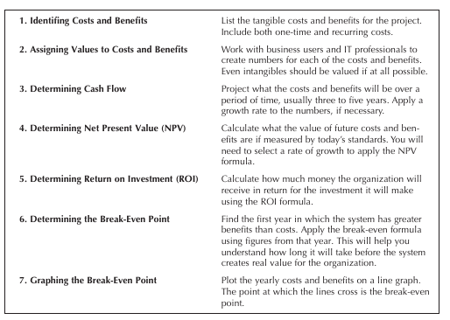
Economic Feasibility – Read yourself
Systems analysts’ time
Cost of systems study
Cost of employees’ time for study
Estimated cost of hardware
Cost of packaged software or software development

Slide 15
Schedule Feasibility
Can We build the solution in a Timely fashion?
Be familiar with the timeline the organisation has set out
Any constraints which could affect the timeline and delay it

Slide 16
Schedule Feasibility Questions
Is it possible to build a solution in time to be useful?
  Are the deadlines reasonable?
  Are all specific deadlines mandatory or desirable.
How long will it take to get the technical expertise?
  May have technology – Do we have the skills to use this technology (do we need to hire new staff, retrain existing staff – this can have an impact on the schedule
What are the consequences of delay?
Any Constraints on the schedule?
Can these constraints be met?
  If not consequences such as delivering the system a few months late, deliver an error prone, useless system on time
Missed schedules are bad, but inadequate systems are worse!

Slide 17
Operational feasibility
Also referred to as organisational feasibility – If we build it, will it be used?
Important the project is strategically aligned with the business
  Evaluate – not just whether a system can work, but also whether a system will work
Important to include all stakeholders and encourage all of them to be part of the process and using the system after it is built
  how do end-users/managers feel about:
  the problem identified, alternative solutions

Slide 18
Operational Feasibility Questions
If the system is developed, will it be used?
Human and social issues can have impact to question
  Potential labour objections? People tend to resist change
  Manager resistance?
  Organisational conflicts and policies? How will the working environment of the end users change, are they able to adapt to these changes
  Socially acceptability?
  Legal aspects and government regulations?

Slide 19
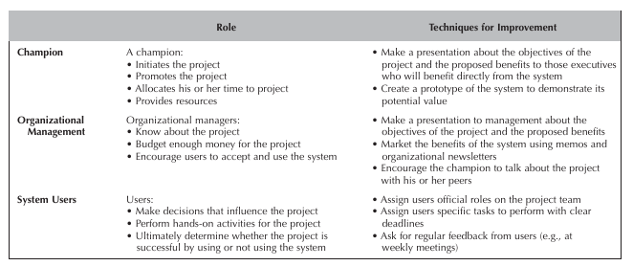
Operational Feasibility – Read yourself
Strategic Alignment
Stakeholder Analysis
Whether the system will operate when installed

Slide 20
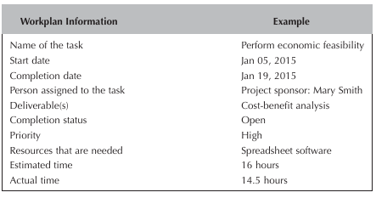
Documentation
Each stage of the feasibility analysis is documented, a front page showing the economic feasibility is below

Slide 21
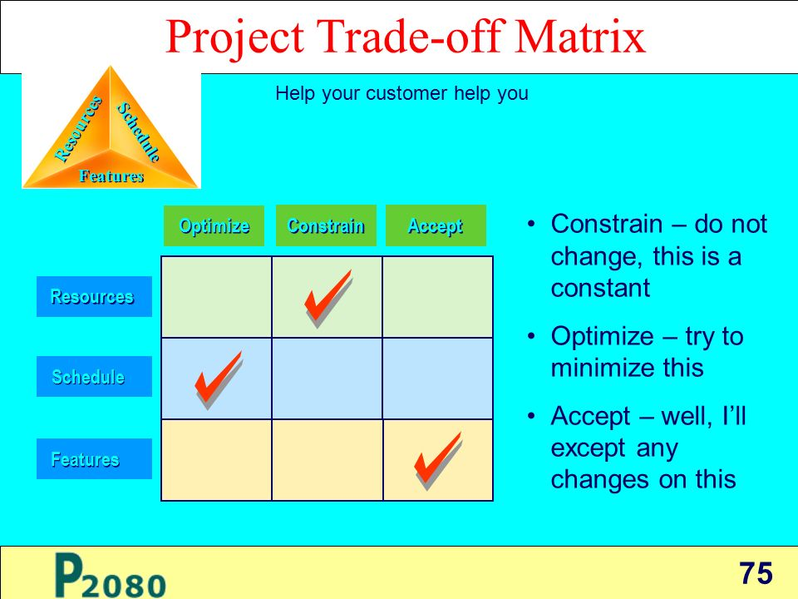
Project Trade-off Matrix
Project effort estimation matrices are sometimes used

Slide 22
Benefits Costs
Tangible Benefits
  Readily quantified as $ values
  Examples:
    increased sales
    cost/error reductions
    increased throughput/efficiency
    increased margin on sales
    more effective use of staff time
Intangible benefits
  Difficult to quantify
    But maybe more important!
    business analysts help estimate $ values
  Examples:
    increased flexibility of operation
    higher quality products/services
    better customer relations
    improved staff morale
How will the benefits accrue?
  When - over what timescale?
  Where in the organization?
Development costs (OTO)
  Development and purchasing costs:
    Cost of development team
    Consultant fees
    software used (buy or build)?
    hardware (what to buy, buy/lease)?
    facilities (site, communications, power,...)
  Installation and conversion costs:
    installing the system,
    training personnel,
    file conversion,....
Operational costs (on-going)
  System Maintenance:
    hardware (repairs, lease, supplies,...),
    software (licenses and contracts),
    facilities
  Personnel:
    For operation (data entry, backups,…)
    For support (user support, hardware and software maintenance, supplies,…)
    On-going training costs

Slide 23
Analyzing Costs vs. Benefits
Identify costs and benefits
  Tangible and intangible, one-time and recurring
  Assign values to costs and benefits
Determine Cash Flow
  Project the costs and benefits over time, e.g. 3-5 years
  Calculate Net Present Value for all future costs/benefits
    determines future costs/benefits of the project in terms of today’s pound values
    A pound earned today is worth more than a potential pound earned next year
Do cost/benefit analysis
  Calculate Return on Investment:
    Allows comparison of lifetime profitability of alternative solutions.
    ROI = Total Profit = Lifetime benefits - Lifetime costs
    Total Cost Lifetime costs
  Calculate Break-Even point:
    how long will it take (in years) to pay back the accrued costs:
  @T (Accrued Benefit > Accrued Cost)

Slide 24
Calculating Present Value (PV)
A pound today is worth more than a pound tomorrow…
  PV returns the current value of a future sum of money for a specified rate of return
The discount rate (investment rate of return which is applied to the present value calculation)
  measures opportunity cost:
    Money invested in this project means money not available for other things
    Benefits expected in future years are more prone to risk
    Higher the discount rate, the lower the present value of future cash flow
  This number is company- and industry-specific, related to how the company gets its funds e.g. if shareholders expect a 12% return, that is the discount rate used for PV
  Determining the appropriate discount rate is key to true valuing of future cash flows
    “what is the average annual return for investments in this industry?”
Present Value:
  The “current year” pound value for costs/benefits n years into the future
    … for a given discount rate r
  FV
  Present Value = (1 + r)^{n}
  If you expect to earn £5000 in five years time, if the discount rate is 8.25% and need to calculate what the payment will be worth today
    Present_Value = £5000/(1.0825)5=3,363.80
FV = Future Value
r = Rate of Return
n = Number of periods
Fernando et al, 2022

Slide 25
Net Present Value
Measures the total value of the investment
  …with all figures adjusted to present pound values
    NPV = Cumulative PV of all benefits - Cumulative PV of all costs
  Assuming subsequent years are like year 4…
    the net present value of this investment in the project will be:
    after 5 years, £13,652
    after 6 years, £36,168

Slide 26
Return on Investment (ROI) analysis
For comparing overall profitability
  Which alternative is the best investment?
  ROI measures the ratio of the value of an investment to its cost.
ROI is calculated as follows:
  ROI = Estimated lifetime benefits - Estimated lifetime costs
  Estimated lifetime costs
  or:
  ROI = Net Present value / Estimated lifetime costs
  For our example
    ROI = (795,440 - 488,692) / 488,692 ≈ 63%,
    or ROI = 306,748 / 488,692 ≈ 63%
Solution with the highest ROI is the best alternative
  But need to know payback period too to get the full picture
    E.g. A lower ROI with earlier payback may be preferable in some circumstances
Beattie & James, 2022

Slide 27
Feasibility Study Contents
Purpose & scope of the study
  Objectives (of the study)
  who commissioned it & who did it,
  sources of information,
  process used for the study,
  how long did it take,…
Description of present situation
  organizational setting, current system(s).
  Related factors and constraints.
Problems and requirements
  What’s wrong with the present situation?
  What changes are needed?
Objectives of the new system.
  Goals and relationships between them
Possible alternatives
  …including ‘do nothing’.
Criteria for comparison
  definition of the criteria
Analysis of alternatives
  description of each alternative
  evaluation with respect to criteria
  cost/benefit analysis and special implications.
Recommendations
  what is recommended and implications
  what to do next;
    E.g. may recommend an interim solution and a permanent solution
Appendices
  to include any supporting material.

Slide 28
Comparing Alternatives
How do we compare alternatives?
When there are multiple selection criteria?
When none of the alternatives is superior across the board?
Use a Feasibility Analysis Matrix!
The columns correspond to the candidate solutions;
The rows correspond to the feasibility criteria;
The cells contain the feasibility assessment notes for each candidate;
Each row can be assigned a rank or score for each criterion
e.g., for operational feasibility, candidates can be ranked 1, 2, 3, etc.
A final ranking or score is recorded in the last row.
Other evaluation criteria to include in the matrix
quality of output
ease of use
vendor support
cost of maintenance
load on system

Slide 29
Initial Project Definition
Date: 08/10/2020
Project: University Bookstore System
The Problem: To process method of processing textbook order is slow and error-prone. Queries regarding orders are difficult or impossible to answer.
Scope of the problem: The solution should require no more than 12 months with a maximum expenditure of £100000.
Objectives: To investigate the potential for installing a new system to efficiently handle textbook orders for college courses. The new system must be able to respond quickly to inquires regarding orders and the status of textbook inventory.
Scope of the Proposal: Three weeks at ta total cost of £6000.
Project Output: The report of the feasibility study will include
Statement of the problems in the current textbook system
Preliminary design of a computer-based information system, if deemed feasible, or specifications for and improved manual record-keeping system
Estimated cost and time requirements to implement the proposed system
Tentative schedule for system implementation
The report will be delivered no later than five weeks after the signing of the contract.

Slide 30
Activity Based Cost Analysis
Identify all the activities required to create the product.
Divide the activities into cost pools, which includes all the individual costs related to an activity—such as manufacturing. Calculate the total overhead of each cost pool.
Assign each cost pool activity cost drivers, such as hours or units.
Calculate the cost driver rate by dividing the total overhead in each cost pool by the total cost drivers.
Divide the total overhead of each cost pool by the total cost drivers to get the cost driver rate.
Multiply the cost driver rate by the number of cost drivers.

Slide 31
Useful links
Feasibility Study
https://www.projectmanager.com/training/how-to-conduct-a-feasibility-study
ABC
https://www.business-case-analysis.com/activity-based-costing.html
ROI
https://www.investopedia.com/articles/basics/10/guide-to-calculating-roi.asp
Present Value
https://www.investopedia.com/terms/p/presentvalue.asp

Slide 32
Questions
???

Slide 33
Tasks
Read through the links provided on page 32
Any remaining time of the session can be used for your Assignment.

Slide 34
References
Beattie, A. & James, M (2022) A Guide to Calculating Return on Investment (ROI). [Online] Available from: https://www.investopedia.com/articles/basics/10/guide-to-calculating-roi.asp [Accessed 3 February 2022]
Fernando, J., James, M., Courage, A. (2022) Present Value (PV). [Online] Available from: https://www.investopedia.com/terms/p/presentvalue.asp [Accessed 3 February 2022]

